Slide 1
CHICAGO

Slide 2
Terraform, AWS CodePipeline, and The Enterprise Free Tier
DEV03
John Merline
Cloud Architect
SPR

Slide 3
Related breakouts
SVC311: Self-Service Remediation, Managing Configuration Drift, & Automation
Brian Beach, Thorr Giddings, Eric Westfall
DEV02: Souped-Up CI/CD on AWS
Forrest Brazeal

Slide 4
Why Terraform?
data "aws_vpcs" "vpcs" {} # Count the number of existing VPCs
locals { cidr_block="${cidrsubnet("172.30.0.0/16", 4, length(data.aws_vpcs.vpcs.ids)-1)}” }
data "aws_vpc" "vpc_peer" { tags { Name = "natureofclouds-core-vpc" }}
data "aws_route_table" "vpc_peer" { tags { Name = "natureofclouds-core-public-rtb" }}
resource "aws_vpc_peering_connection" "peer" {
peer_vpc_id = "${data.aws_vpc.vpc_peer.id}"
resource "aws_route" "from_vpc_peer_public" {
route_table_id = "${data.aws_route_table.vpc_peer.id}"
destination_cidr_block = "${local.cidr_block}"

Slide 5
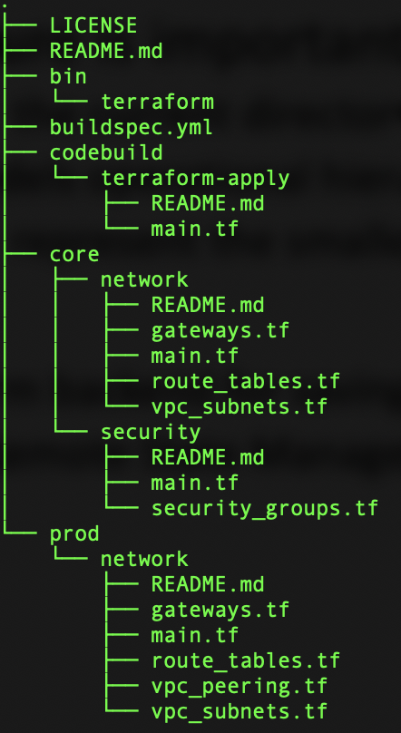
Running Terraform
Run from laptop?
Local credentials
Logs not captured
Local state files
Directory structure is important
All *.tf files within the current directory concatenated together
Directory tree models operational hierarchy -> account/project/component
Leaves of the tree represent the smallest unit of terraform state
State Files
Configure terraform backend for saving state in S3 bucket
Terraform Cloud Remote State Management

Slide 6
Demo

Slide 7
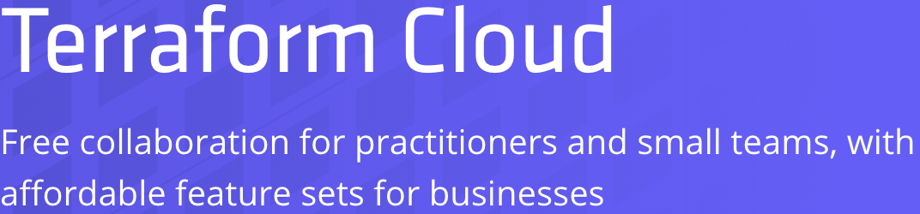
A Cloud Guru
Original AWS training site with largest student body
Primarily AWS training with some Azure, GCP, Linux, Security, DevOps
Full membership includes original series like AWS This Week, Alexa Devs, …
Videos from Serverlessconf which they run and sponsor
Can purchase discounted courses via Udemy
Topic specific deep dives on RDS, S3, Redshift, DynamoDB, Cloud Formation, …

Slide 8
Terraform Cloud
State Storage, Locking, and History (Available Now)
Automatically store and access state remotely whenever and wherever you run Terraform. State access is automatically locked during operations.
https://www.hashicorp.com/blog/introducing-terraform-cloud-remote-state-management
Collaborate on Plans and Applies (Coming Soon)
Comment, iterate, and approve proposed infrastructure changes with your team. Integrate directly with a VCS such as GitHub to trigger runs automatically for Pull Requests.
Full Workflow with the CLI, API, or GUI (Coming Soon)
Plan and apply remotely using the standard terraform CLI, a full HTTP API, or the web UI. Invoke Terraform from any CI system without losing any collaboration features.
Terraform Packages
Not clear what features will be included in the free tier
https://www.hashicorp.com/products/terraform/offerings

Slide 9

Things To Know
CodeBuild service role needs admin privileges
Terraform is creating infrastructure
Write access to source code repo implies admin rights
Pipeline Alternatives
Have run Terraform with Jenkins and Bash scripts in the past
AWS CodeBuild and the other developer tools provide a managed alternative with free tier
What about Cloud Formation?
Has added many new capabilities over the last few years
Deep integration with other AWS services

Slide 10
Under Construction
Customized docker image for Terraform
https://hub.docker.com/r/hashicorp/terraform/
http://lukkhacoder.com/posts/technical/2018/terraform-in-docker-with-azure-02/
Add multiple inputs to Build Project
Run Terraform across multiple components within a project
Add testing stages as part of full Code Pipeline
Explore integration with Terraform Cloud
Switch remote state from current S3 bucket
Integrate new workflow CLI when available
Create a pipeline to generate Terraform
Checks generated code into repo
Uses templating language like Jinja (or possible macros)

Slide 12
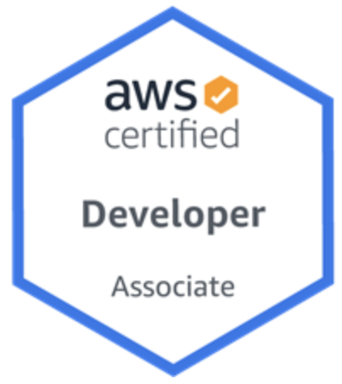
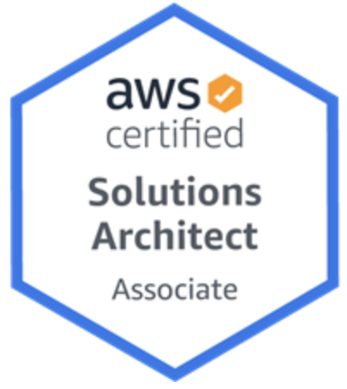
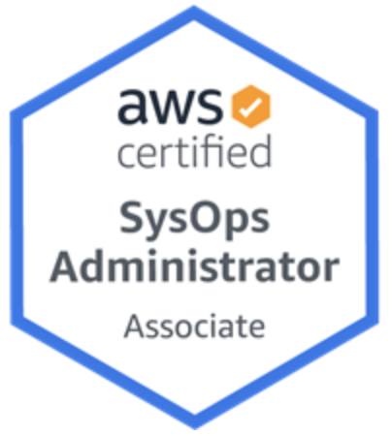
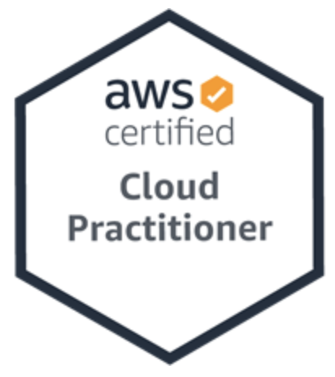
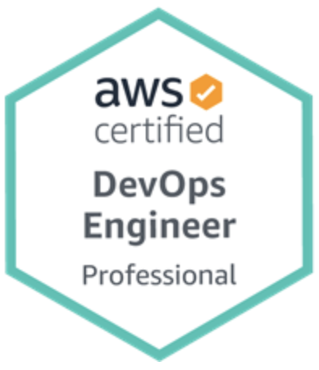
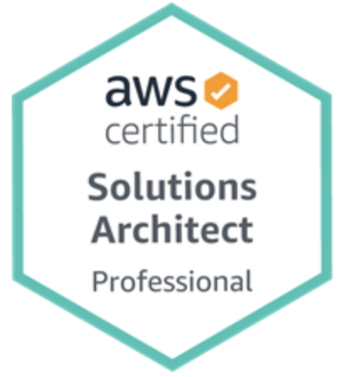

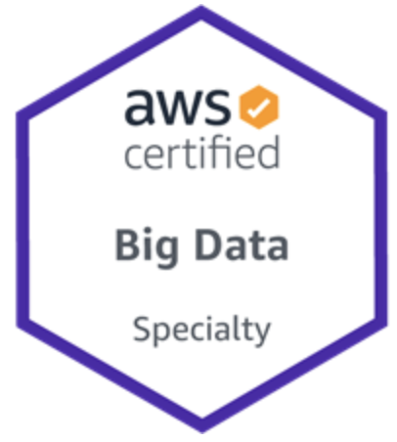
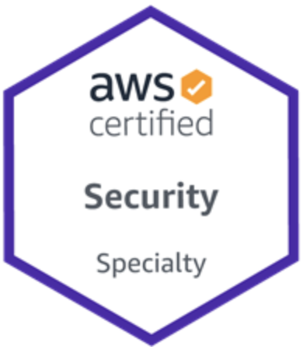
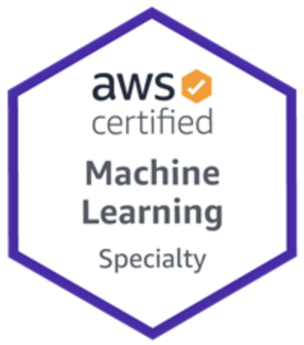
John Merline
@natureofclouds
https://www.linkedin.com/in/johnmerline/
https://www.facebook.com/pg/natureofclouds/posts/
https://github.com/natureofclouds/aws-codebuild-terraform

